Slide 1



Team members:
Biju Balakrishnan Nair (CEO), Dimitrios Pavlopoulos (CFO), Liyan Miao (COO) & Syed Zahed Ali (CTO)

Slide 2
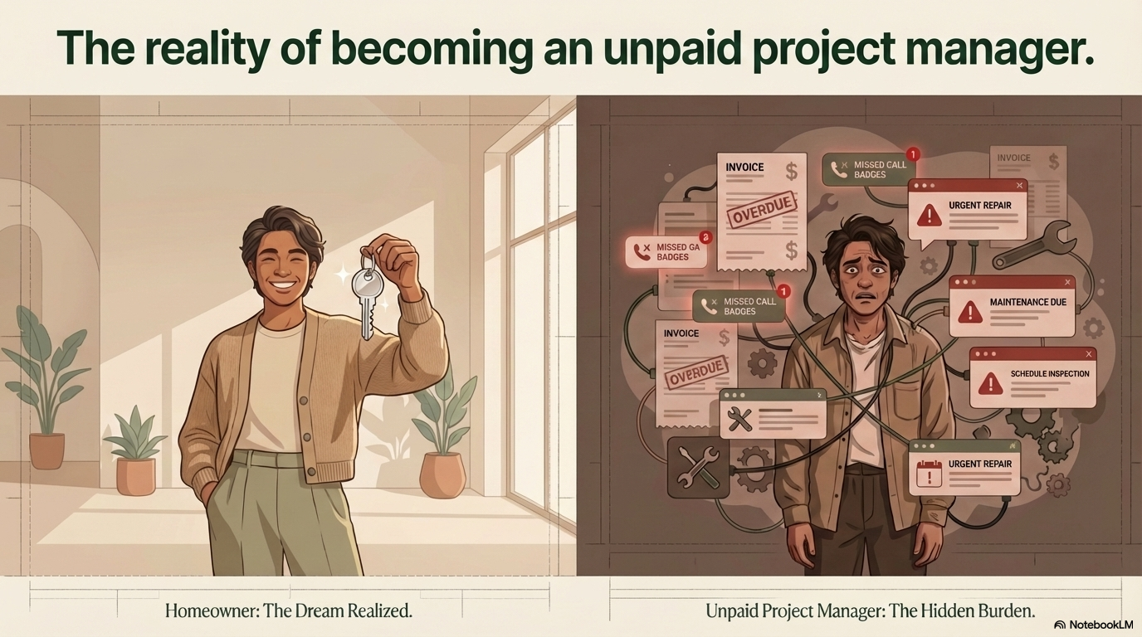

2

Slide 3

3

Slide 4

4

Slide 5
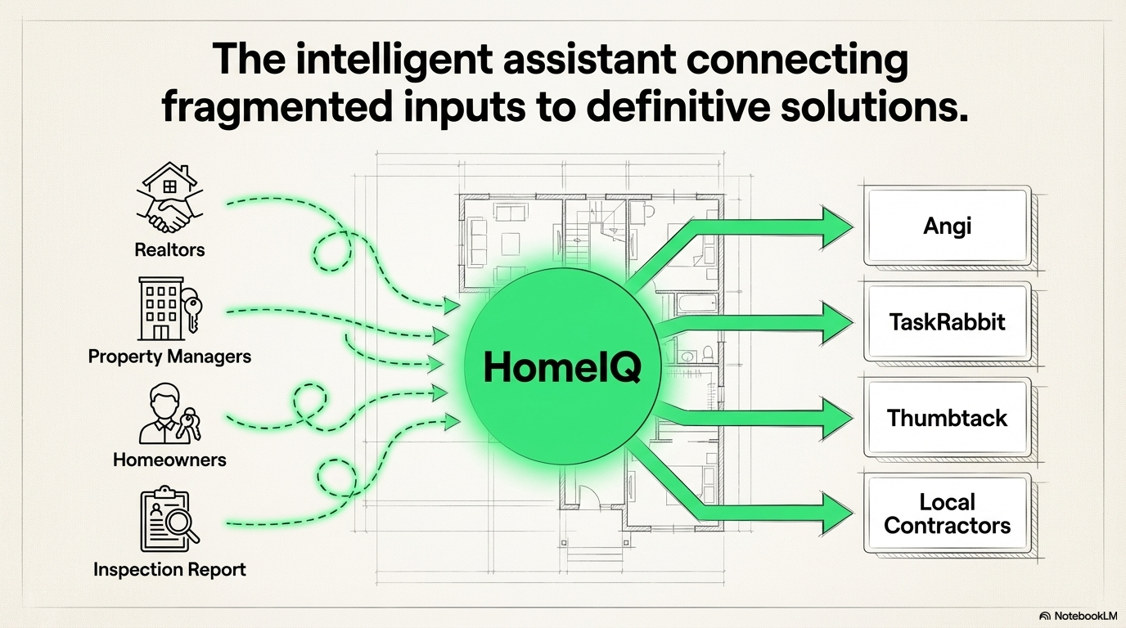
5

Slide 6
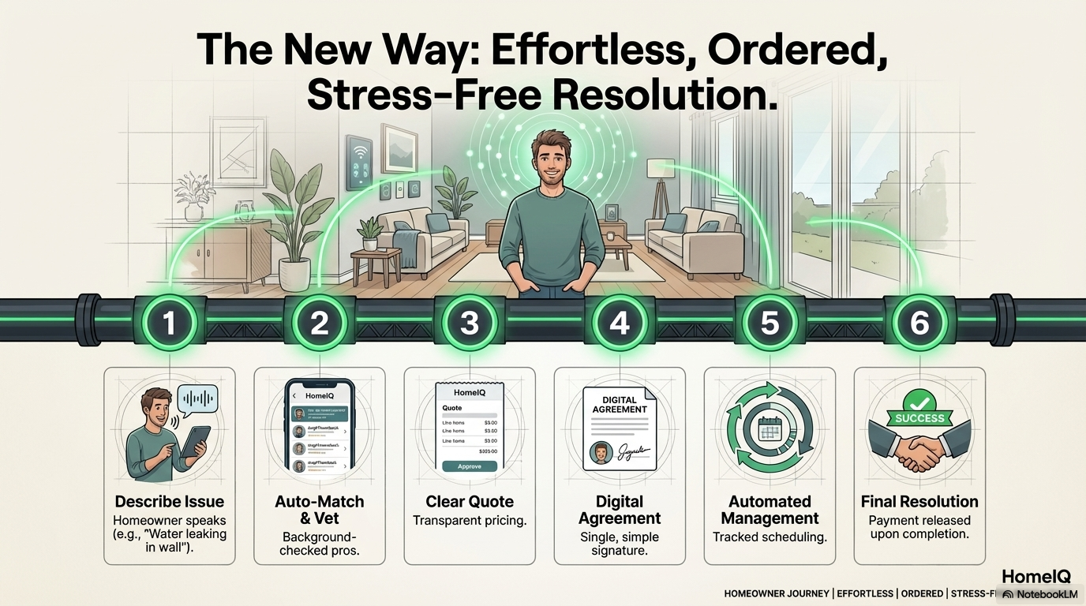
6

Slide 7
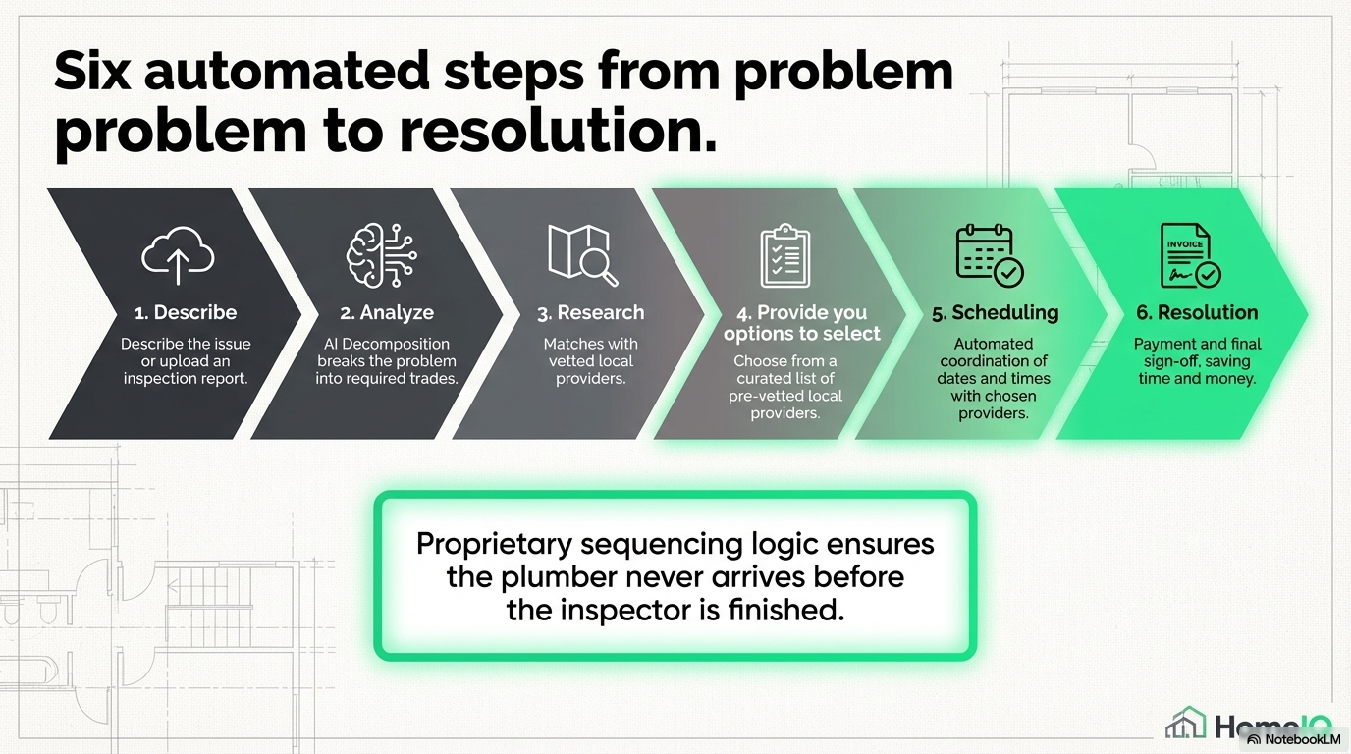
7

Slide 8
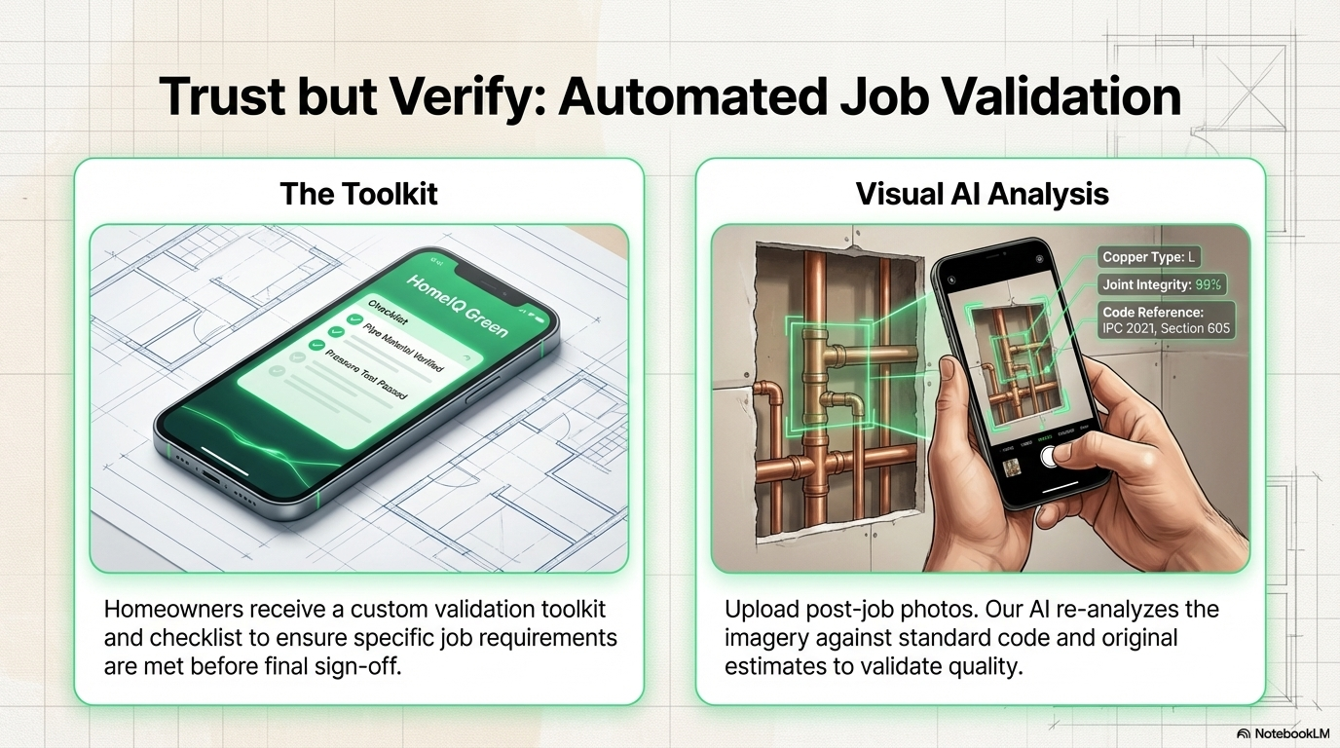
8

Slide 9
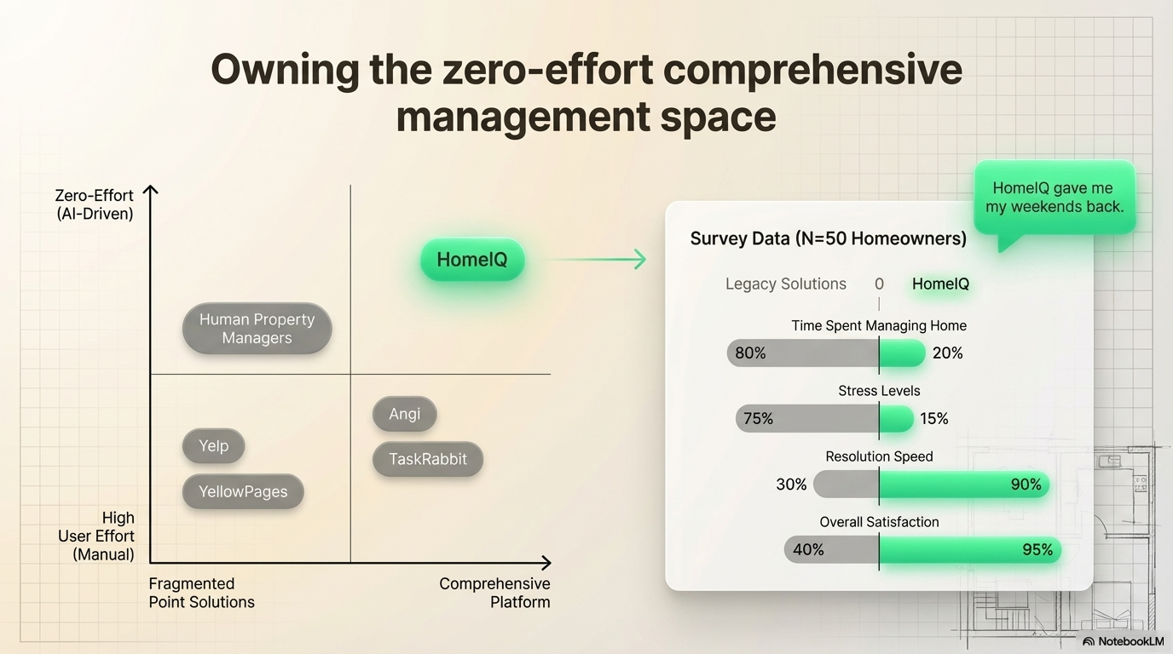
9

Slide 10
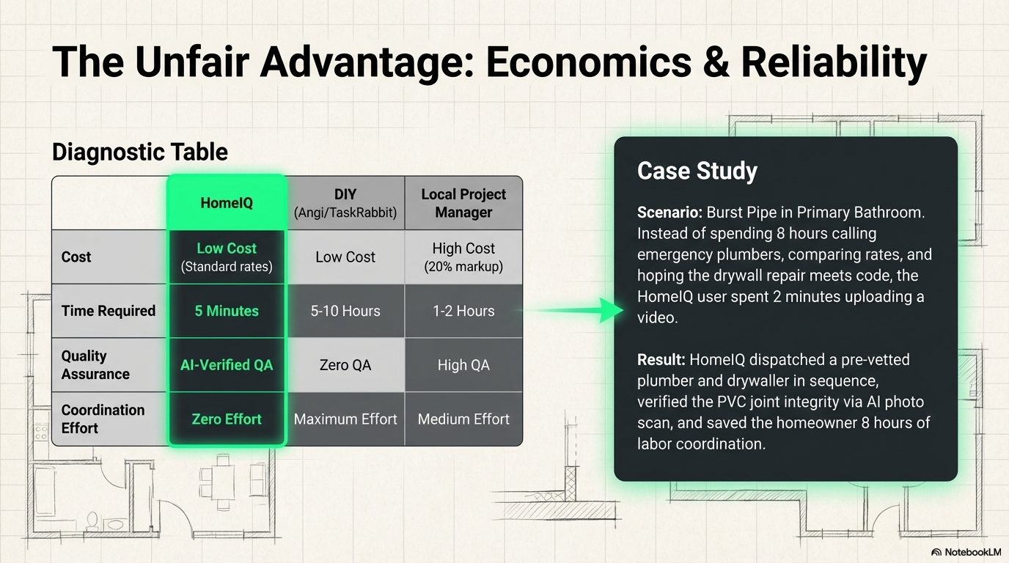
10

Slide 11

11

Slide 12
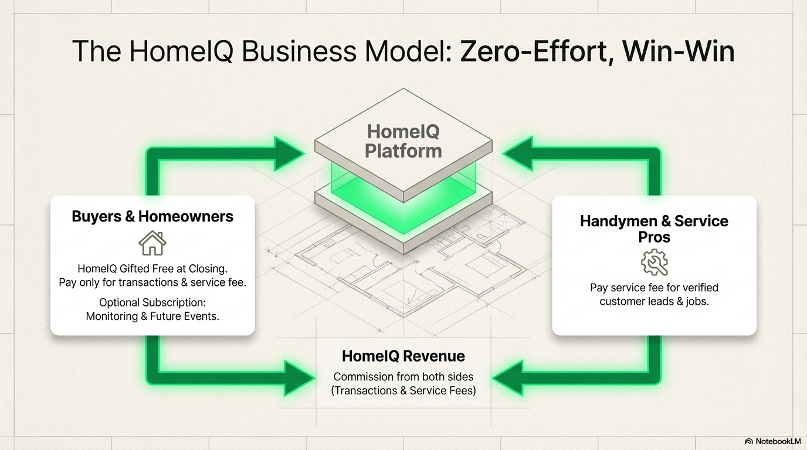
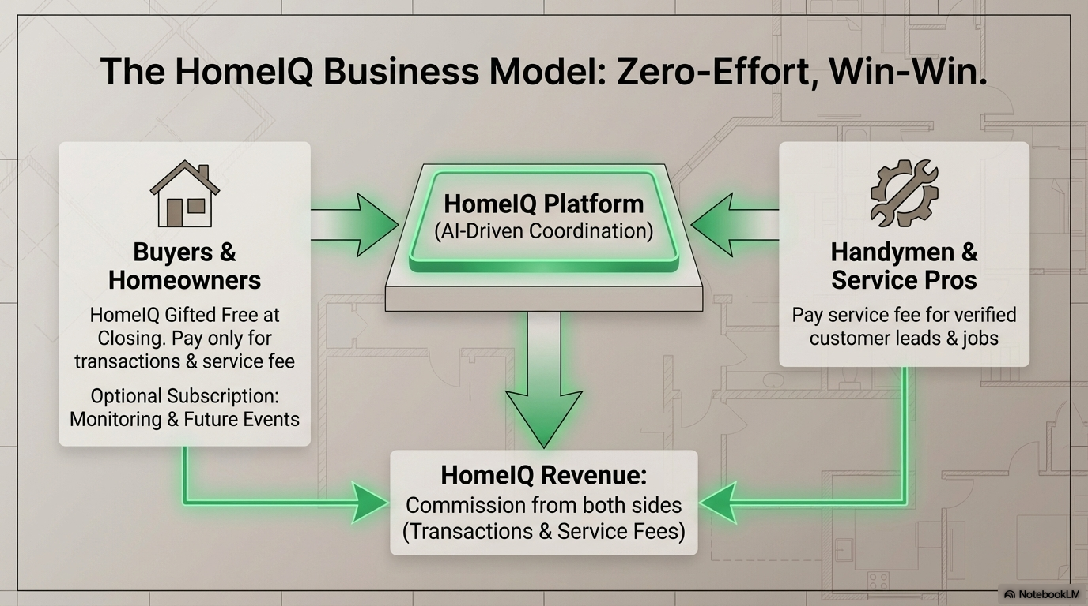
Premium Subscription
Monitoring & Future Events
5%
10%
12

Slide 13
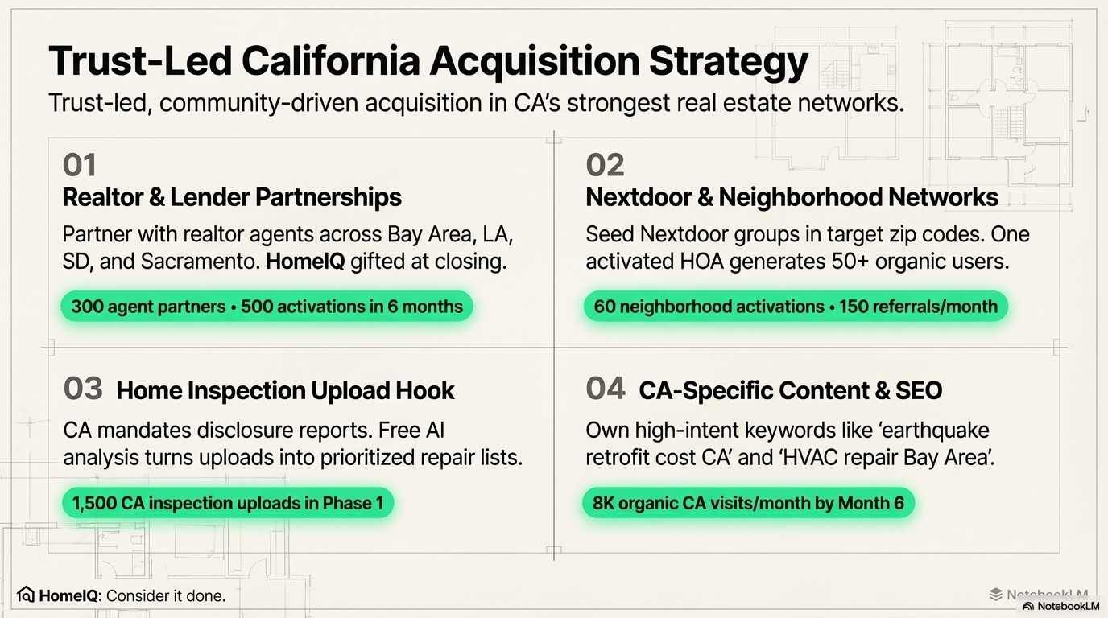
13

Slide 14

14

Slide 15
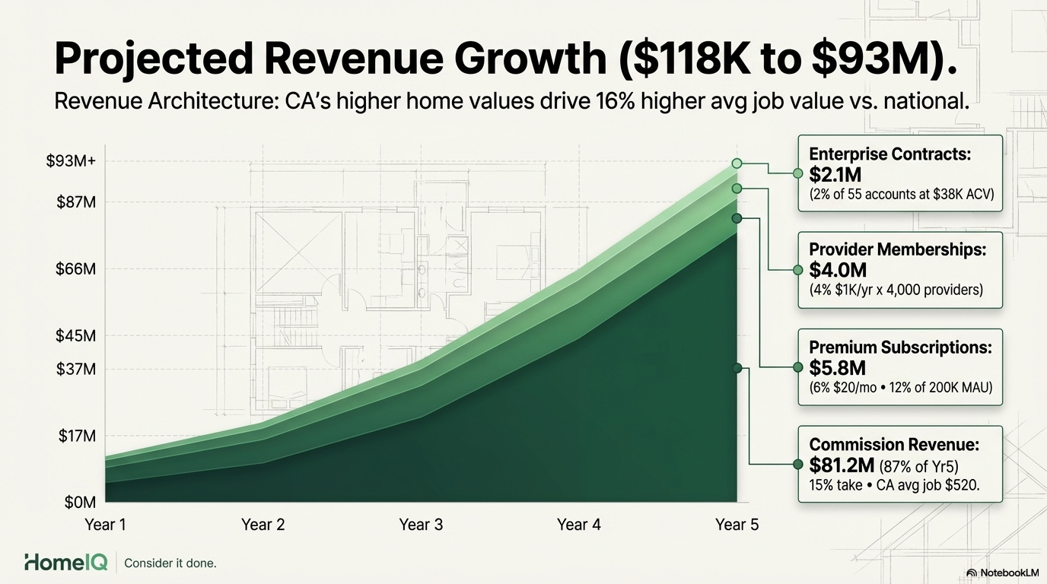
15

Slide 16
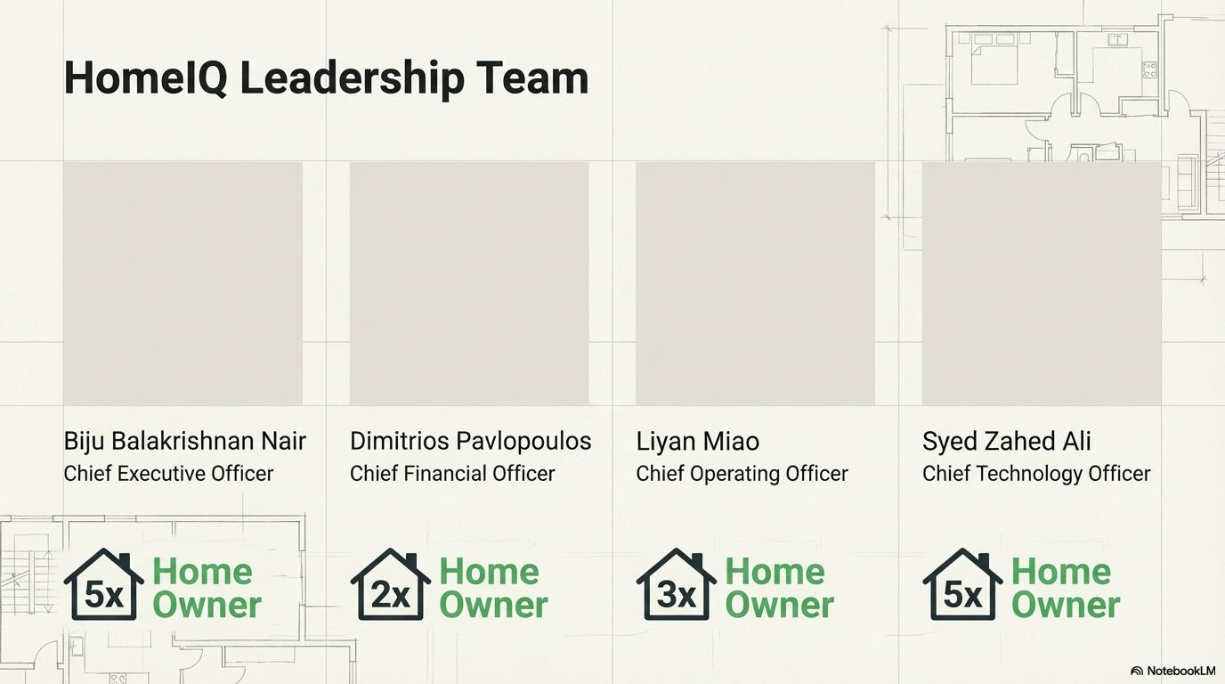
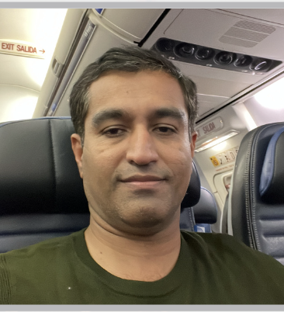
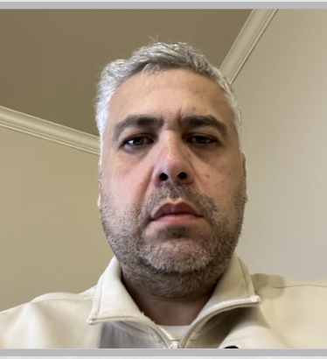
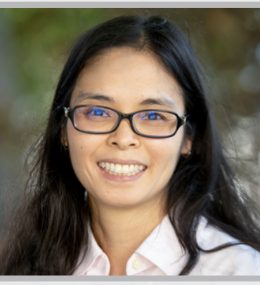
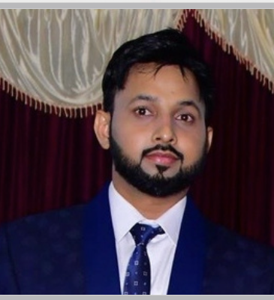
16

Slide 17
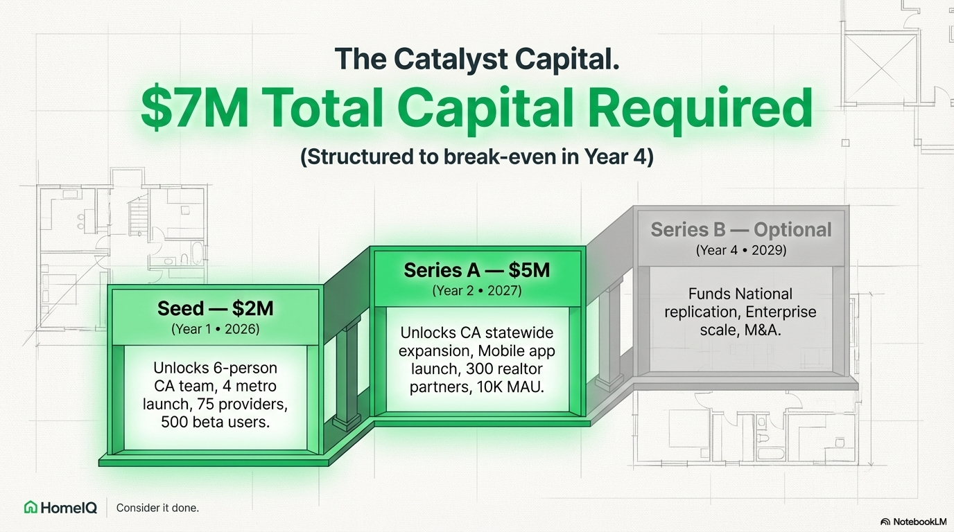
17

Slide 18

Invest in HomeIQ.
Maximize your property value.
Consider it done.
18

